Slide 1
Fading Channel Simulator
1조 박준모
박지원
윤철훈

Slide 2

$$f_{max}=\frac{v}{c_{0}}f_{0}$$
$$μ\left(t\right)= μ_{1}\left(t\right)+jμ_{2}(t)$$
$$ς(t) = |μ\left(t\right)|$$
$$\tilde{μ_{i}}(t) = \sum_{n=1}^{N_{i}}{C_{i,n}cos⁡(2πf_{i,n}t+θ_{i,n})}$$

Slide 3
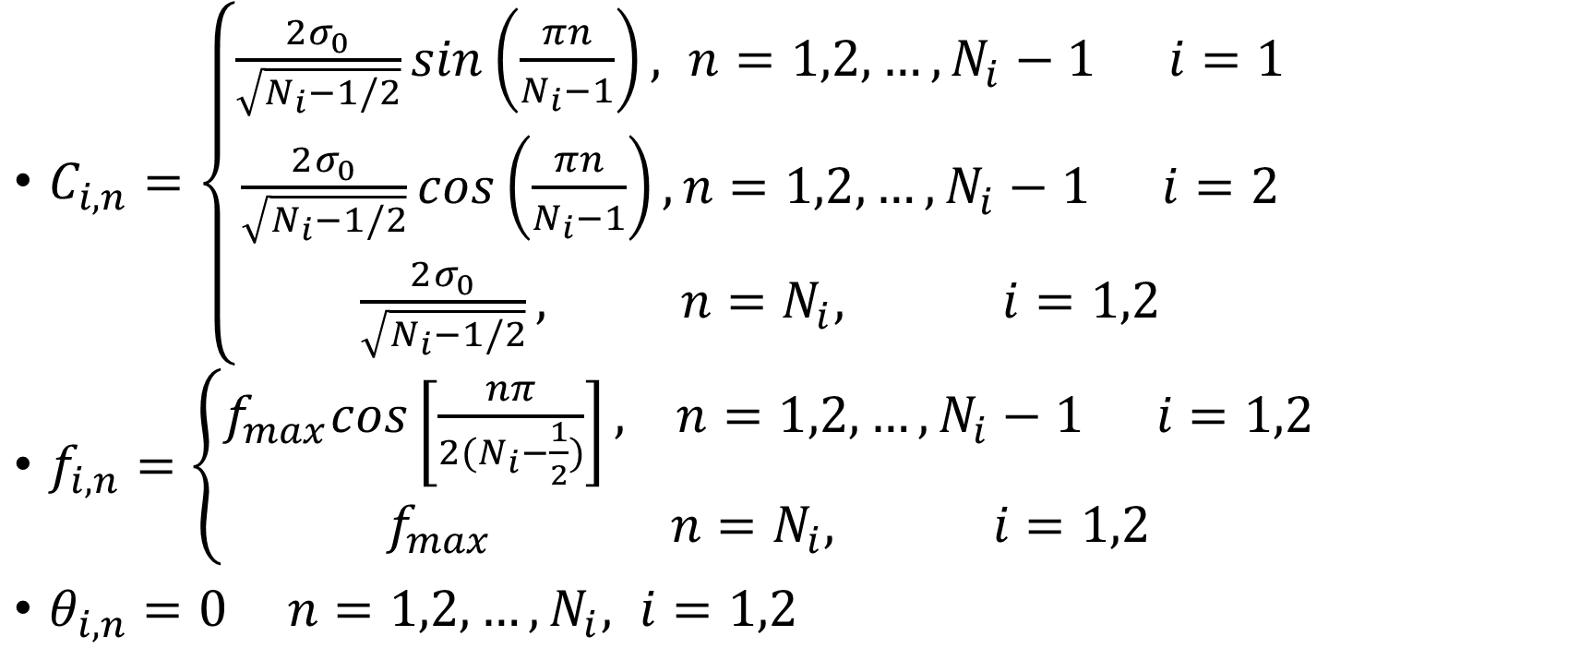
$$C_{i,n}=\left\{\begin{aligned}\frac{2σ_{0}}{\sqrt{N_{i}−1/2}}sin\left(\frac{πn}{N_{i}−1}\right), n=1,2,…,N_{i}−1 i=1 \\ \frac{2σ_{0}}{\sqrt{N_{i}−1/2}}cos\left(\frac{πn}{N_{i}−1}\right),n=1,2,…,N_{i}−1 i=2 \\ \frac{2σ_{0}}{\sqrt{N_{i}−1/2}}, n=N_{i}, i=1,2\end{aligned}\right.$$
$$f_{i,n}=\left\{\begin{aligned}f_{max}cos\left[\frac{nπ}{2(N_{i}−\frac{1}{2})}\right], n=1,2,…,N_{i}−1 i=1,2 \\ f_{max} n=N_{i}, i=1,2\end{aligned}\right.$$
$$θ_{i,n}=0 n=1,2,…,N_{i}, i=1,2$$

Slide 4
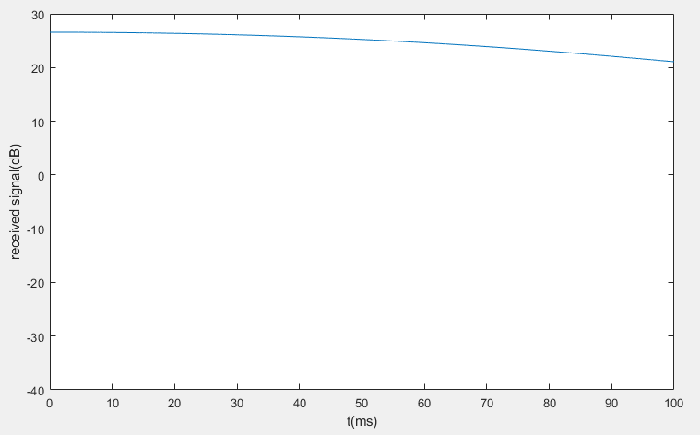
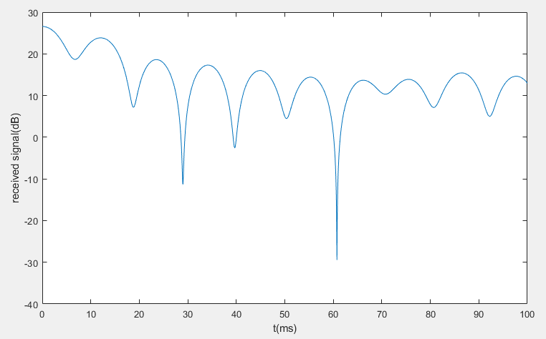
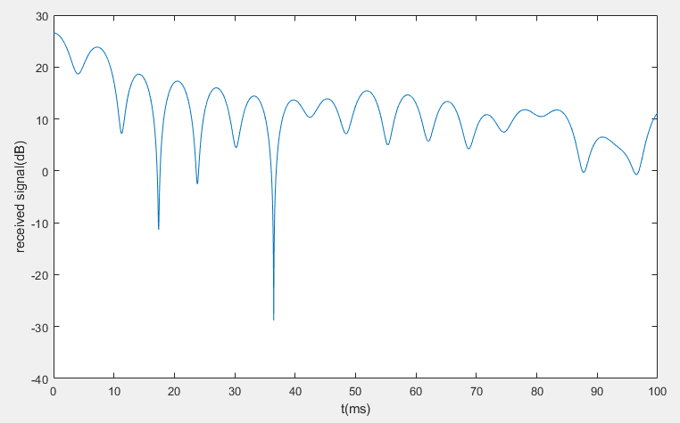
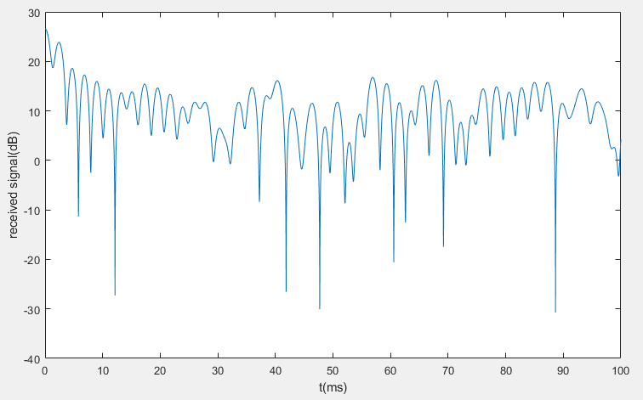
850MHZ
Channel result(abs) 3Km/h
Channel result(abs) 60Km/h
Channel result(abs) 100Km/h
Channel result(abs) 300Km/h

Slide 5
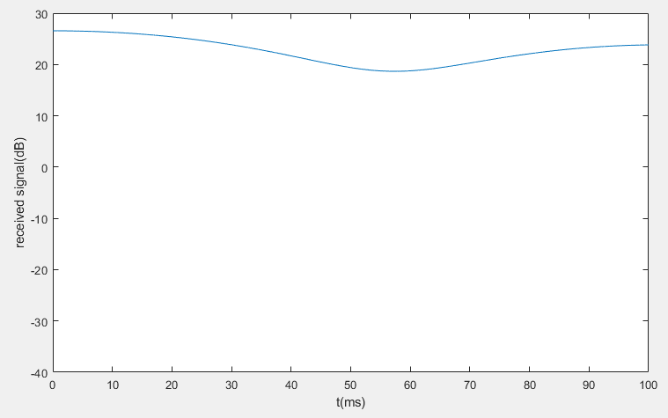
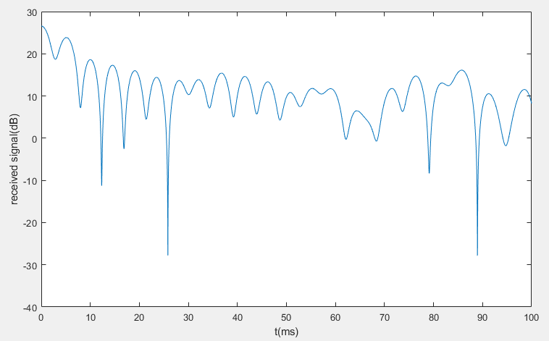
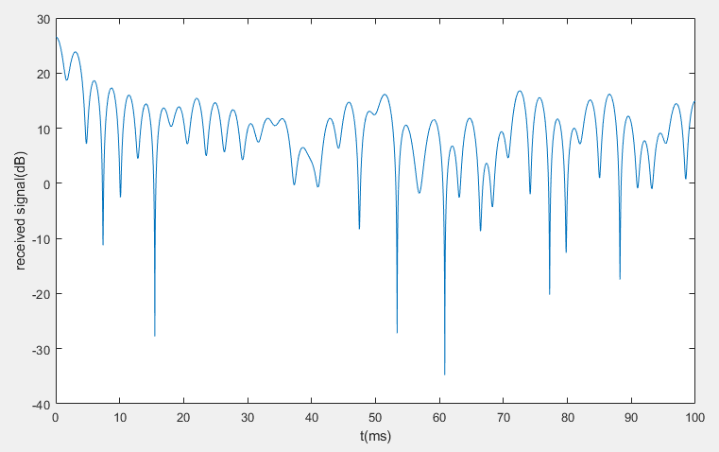
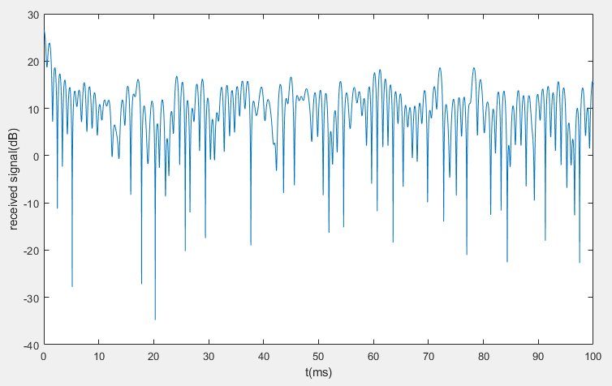
2GHZ
Channel result(abs) 3Km/h
Channel result(abs) 60Km/h
Channel result(abs) 100Km/h
Channel result(abs) 300Km/h

Slide 6
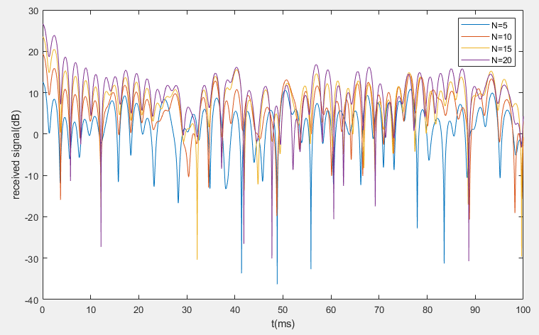
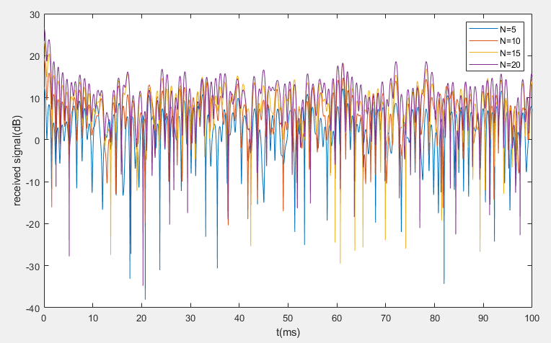
850MHz - 300Km/h
2GHz - 300Km/h

Slide 7
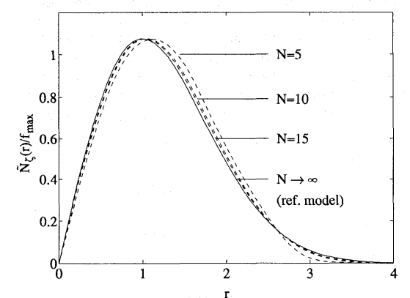
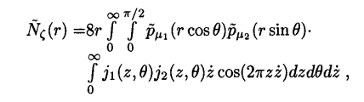
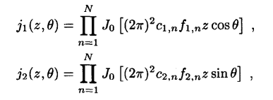

PDF of LCR(level-crossing rate)
논문 “STATISTICAL PROPERTIES OF JAKES’ FADING CHANNEL SIMULATOR” 에서 발췌

